Slide 1
Probabilistic Proof System
— An Introduction
Deng Yi
CCRG@NTU

Slide 2
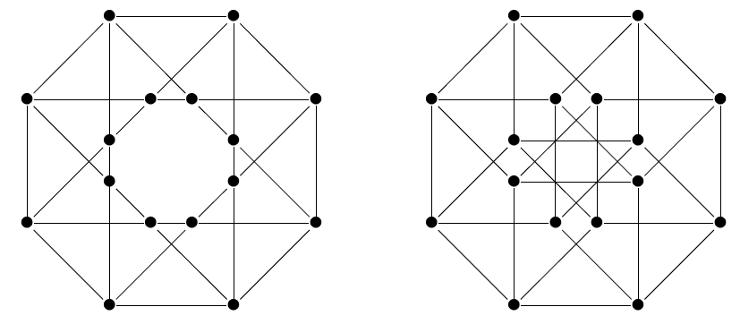
A Basic Question
Suppose:
You are all-powerful and can do cloud computing (i.e., whenever you are asked a question, you can give the correct answer in one second by just looking at the cloud overhead)
I am reasonable…
Given two huge graphs, G₀ and G₁
You know they are NOT isomorphic
The Question: If I have only one hour with you, Could you convince me that they are NOT isomorphic?

Slide 3
Plan
PART 1: Zero Knowledge Interactive Proofs
PART 2: ZKIP to PCP
PART 3: PCP to ZKIP

Slide 4
PART 1:
Zero Knowledge Interactive Proofs

Slide 5
Goldwasser, Micali and Rackoff gave a rigorously algorithmic definitions on zero knowledge and interactive proofs in 1985, the latter was also independently introduced by Babai in the same year
They added two ingredients to the traditional proofs:
Interaction
Randomness

Slide 6
Traditional math proof: NP-proof system
Write a proof w for a theorem X, send it to the reviewer
P V
w
P: the prover
V: deterministic polynomial-time verifier
NP statements: theorem X is a NP statement if
it has a short proof w

Slide 7

Zero knowledge interactive proof/argument
Unbounded/poly-time
P
poly-time
V
x ∈L
m₁
m₂
m₃
m₄
accept/reject
Completeness: for all x ∈L , Pr[V accepts] ≥1-neg
Soundness: for all x∉L, any (unbounded/poly-time)
P*, Pr[V accepts] <neg
Zero knowledge: for all x ∈L, any V*, there exists
ppt S such that
ViewV* <P,V*>(x)≈ S (x)
“≈”：perfect，statistical，computational indist.

Slide 8
Zero knowledge
x ∈L
V
X（without w）
P(w)
m₁
S
m₂
(x,r)
m₃
≈
m₄
V*
accept/reject
(x,r,m₁,m₂,m₃,m₄,acc)
Typically, there are two ways that S uses the verifier V* in computation:
Black-box: treat V* as a black-box and use rewinding technique;
Non-black-box: use the code of V*

Slide 9
Witness Indist. Interactive proof/argument [FS90]
Witness indistinguishability
Common input：x ∈L
(x,w₁)∈R_{L} and (x,w₂)∈R_{L}
P（w₁）
V
P（w₂）
V
m₁
m₁
m₂
m₂
m₃
≈
m₃
m₄
m₄
accept/reject
accept/reject

Slide 10
An example: ZK proof for Graph Isomorphism
Common input: G₀ , G₁ (φ : G₀ ~G₁ )
Zerok nowledge
Simulator S
input : (G₀ , G₁ )∈ISO
Step1: choose random tape for V*
Step2: randomly choose k=0 or 1,
and perm. π, send H=
π(G_{k}) to V*
Step 3: when received the bit i
from V*, if i=k, output
(H, j, π)
otherwise, go back toste p1
Randomly choose π,
set H=π(G₁)
completeness
P
H
V
Randomly choose i=0 or1
i
Soundness
Soundness error1/2，but we can reduce it by sequential repetition
If i=1, set Ψ= π
If i=0, set Ψ= πoφ ⁻¹
No hardness assumption!
Ψ
V accpts iff
Ψ : G_{i} ~ H
Thm:Graph Iso. has a ZK proof system

Slide 11
Zero knowledge proofs for all NP [GMW 86]
Zero knowledge proof system for NP
An NP-complete problem: Graph-3-Coloring

Slide 12

Zero knowledge proof for G-3C
Zero knowledge proof system for Graph-3-Coloring
1
1
1
2
2
Prover chooses a random color
permutation.
2
3
3
3
4
4
4
1. Prover puts all the vertices colors inside envelopes And sends them to the verifier.
5
5
5
2. Verifier sends a query edge, say (4,5).

Slide 13
Zero knowledge proof for G-3C
Zero knowledge proof system for Graph-3-Coloring
3. Prover opens the envelopes 4 and 5, revealing
the colors.
1
1
1
2
2
2
3
3
3
4
4
4
5
5
5
4. Verifier accepts if the colors are different.

Slide 14
Zero knowledge proof for G-3C
Common input：3-colorable G，denote the colors
for the n vertices by col(1),…,col(n) resp.
φ：{1，2，3} {1，2，3}
φ（col(1)）=c₁,
… ,
φ（col(n)）=c_{n}
Soundness error is (1- 1/|E|), we can reduce it by sequential repetition
P
Com(c₁),…, Com(c_{n})
V
e=(u, v) ∈ _{R}E
c_{u}, c_{v}

Slide 15
composition：sequential repetition
x ∈L
P
V
Advantages
Reduce soundness error
Preserve zero knowledge
Disadvantage
Increase round complexity

Slide 16
Composition: parallel repetition
ZK proof for G-3C
Com(c₁¹),…, Com(c_{n}¹)
Com(c₁^{n}),…, Com(c_{n}^{n})
Disadvantage
Don’t preserve black-box zero knowledge
P
Com(c₁),…, Com(c_{n})
V
e₁=(u,v),…,e_{n}=(t,w)
e=(u, v) ∈ _{R}E
advantages
Reduce soundness error
Preserve round complexity
Preserve WI
(c_{u}¹,c_{v}¹),…,(c_{t}^{n}, c_{w}^{n})
c_{u}, c_{v}
A fundamental question：Does there exist 3-roudn ZK proof for non-trivial language?

Slide 17
Getting constant-round ZK proof for G-3C with negligible soundness error
Com(e₁),……, Com(e_{n})
V
P
Com(c₁¹),…, Com(c_{n}¹)
Com(c₁^{n}),…, Com(c_{n}^{n})
e_{1,……} e_{n}
(c_{u}¹,c_{v}¹),…,(c_{t}^{n}, c_{w}^{n})

Slide 18
Application of GWM
Assume two parties, A and B want to compute f(x,y), where x is the private input of A, and y is private input of B
NO！
Is A cheating me?
Show me x!
A(x)
B(y)
A(x)
B(y)
m₁
m₁
m₂
m₂
Solution
m_{i+1}=g(x,m₁,m₂,…m_{i})
g is some hard-to-invert function
m_{i+1}=g(x,m₁,m₂,…m_{i})
ZK proof that m_{i+1} is correct

Slide 19
Non-interactive ZK proof/argument
Key idea: have a trusted third party generate a common random/reference string such that it would be indist. from the string generated by the simulator which
either is drawn from a special distribution (far from random);
or has a trapdoor

Slide 20
Some fundamental problems about NIZK
Could we design a signature scheme such that a signature is determined uniquely by the public key from some general assumptions, such as OWF or CPA PKE?
Could we base NIZK proof/arguments on worst-case complexity assumption，e.g., from some hard lattice problem?
If YES, we will give positive answers to the following two questions
Could we construct NIZK arguments with efficient prover for NP from OWF or CPA PKE?
If YES, we will give a positive answer to the following question
For encryption scheme, is CPA security equivalent to CCA security?

Slide 21
PART 2
ZKIP to PCP
----- A brief history

Slide 22
Our imagination is very limited!
For a little while after the introduction of interactive proof (IP), theory community has once thought of IP as a slight ramdomized extension of NP

Slide 23
In 1986, Goldreich, Micali and Wigderson presented a interactive proof for Graph Non-Isomorphism problem
Common input: G₀ , G₁ ( G₀ is not isomorphic to G₁ )
Randomly choose i=0 or1, and a perm. π, set H=π(G_{i})
P
H
V
i
This protocol should have attracted attention from complexity theory community (observe that GNI is not known to be in NP) at that time, but unfortunately, it didn’t…
Our community believes that GI (hence GNI) is in P. Yet, we have no idea how to prove it… (we just knew that GI is unlikely to be NP-comlete)

Slide 24
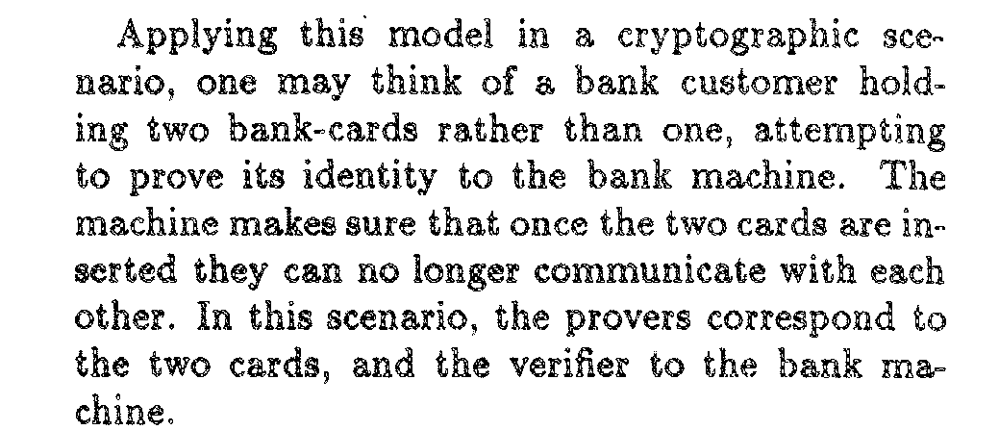
In 1988, Ben-Or, Goldwasser, Kilian and Wigderson introduced multi-prover interactive proof.
Motivation:
The key idea was borrowed from game theory.
In this model, all provers are not allowed to communicate with each other during the proof stage.
Interestingly, it did not receive attention from Crypto community, but it led to a great achievement in complexity theory.

Slide 25

Multi-prover zero knowledge proofs for NP
A key component: realizing commitment in multi-prover model without assuming any hardness assumption
P₁ and P₂ share a random number r {0,1,2}
two publically known permutation:
∈
0 0
0 1
f₁:
1 1
f₂:
1 2
2 2
2 0
To commit to m {0,1}
∈
P₁
P₂
open
Committing phase
C= f_{i}(m)+r
Opening phase
r
i {0,1}
∈
V

Slide 26
On the power of IP and MIP in the relativized world
In 1988, Fortnow, Rompel, and Sipser showed that there exist oracles, relative to which Co-NP is not in IP and MIP
PSPACE
P^{#P}
This casted a cloud over the power of IP and MIP. Any result beating this one in the real world would require new techniques never seen before…
PH
NP
Co-NP
P

Slide 27
Surprising news came in Winter, 1989
Nov. 27, 1989, email announcement from Noam Nisan:
Permanent MIP (which implies PH MIP)
∈
∈
Algebraic technique, which does not relativize
PSPACE
IP(Shamir)
Dec. 13, 1989, email announcement from Lance Fortnow:
Permanent IP (which implies PH IP)
P^{#P}
∈
∈
MIP(Nisan)
IP(LFKN)
Arithmetization
PH
Dec. 26, 1989, email announcement from Adi Shamir:
PSPACE IP (which implies PSPACE=IP)
NP
Co-NP
∈
P

Slide 28


The Problem Permanent
Let S_{n} be the set of all permutations over{1,…,n}.
Given a matrix A=(a_{i,j}) over F_{p},
Which is similar to determinant
The decision problem of Permanent:
Given matirx A over F_{p}, and a number b, decide if
Perm(A)=b
There is a huge gap between them: determinant is in P, but permanent is #P-complete (which contains PH)

Slide 29
The interactive proof for Permanent
Given matirx A over F_{p}, and a number b, P want to convince V that Perm(A)=b
A naïve idea:
a_{1,1}, a_{1,2} ,… , a_{1,n}
…
Note that perm =a_{1,1}per(A_{1,1})+…+a_{1,n}perm(A_{1,n})
Thus, to convince V, P just needs to send per(A_{1,i}) for all
(n-1) × (n-1) matrix A_{1,i}
Repeat this step until the dimension of these minors is 1
But now, the protocol will take n! steps!

Slide 30
The interactive proof for Permanent
Given matirx A over F_{p}, and a number b, P want to convince V that Perm(A)=b
A naïve idea:
a_{1,1}, a_{1,2} ,… , a_{1,n}
…
Note that perm =a_{1,1}per(A_{1,1})+…+a_{1,n}perm(A_{1,n})
Thus, to convince V, P just needs to send per(A_{1,i}) for all
(n-1) × (n-1) matrix A_{1,i}
Way out:
Using polynomial interpolation, we have P prove permanent of a single (n-1) × (n-1) matrix B which is consistent with A

Slide 31
The interactive proof for Permanent
Given matirx A over F_{p}, and a number b in F_{p} (p>n), STATEMENT: Perm(A)=b
Perm(A)=a_{1,1}per(A_{1,1})+…+a_{1,n}perm(A_{1,n})
(x－ j)
Polynomial interpolation: L_{i} (x)= ∏
n
D(x) is a (n-1) ×(n-1) matrix whose entry is a polynomial of degree (n-1), and D(i)=A_{1,i}
(i － j)
j {1,…n}\{i}
∈
D(x)= ∑ L_{i} (x)A_{1,i}
n
P
i
V
g(x)=perm(D(x))
Compute all g(i),
check if b= ∑ a_{1,i}g(i)
If yes, choose a F F_{p} at random
a
∈
computeD(a)=g(a), and set B=D(a)
repeat the above,
now prove that g(a)=perm(B)

Slide 32
We have seen that the membership of some extremely hard problem (which has exponential long traditional proof) can be proved to an efficient verifier via interactive proof.
For the membership of such a hard problem, Can we give a (probably very long) traditional proof without interaction such that an verifier can still check it efficiently?
YES, we can

Slide 33
Roughly speaking, for a statement which admits an interactive proof system,
we can write down all the accepting transcripts of this proof system by enumerating all possible coins of the verifier in advance (this will result in an exponentially long written proof) ,
and then have the verifier randomly check a few locations in this written proof…

Slide 34
Probabilistically checkable proof [PCP]--Defintion
PCP[r(n),q(n)]: set of languages L with p.p.t. verifier V that has (r, q)-restricted access to a string “proof”
  V tosses O(r(n)) coins
  V accesses proof in O(q(n)) locations
  (completeness) x ∈ L ⇒ ∃ proof such that
  Pr[V(x, proof) accepts] = 1
  (soundness) x ∉ L ⇒ ∀ proof*
  Pr[V(x, proof*) accepts] ≤ ½

Slide 35
The power of MIP and its consequence
Around one month after Shamir’s announcement of IP=PSPACE, Babai et al. announced:
MIP=NEXP
View the two separate provers as a Oracle fixed in advance
NEXP = ∪ _{c}PCP[n^{c} , n^{c} ]
There is a proof for the membership L in NEXP such that a verifier needs to check only polynomial number bits.
NP is in ∪ _{c}PCP[log^{c} n, log^{c} n ]
Scaling down by [FGLSS 91] and [BFLS 91]
There is a proof for the membership L in NP such that a verifier needs to check only polylogarithmic number bits (with noticeable soundness error).

Slide 36
The power of MIP and its consequence
Finally, Arora, Lund, Motwani, Sudan and Szegedy[ALMSS 92]; Arora and Safra [AS92] proved the following PCP theorem
NP = ∪_{c} PCP[c logn , O(1) ]
It has had a great impact on hardness approximation

Slide 37
PART 2
PCP to ZKIP

Slide 38
Application of PCP 1: communication-efficient argument
Recall that given a statement x is in L for a NP language L and its proof w，we have the following proof system
P V
w
The communication complexity is |w|=poly(n), where n=|x|

Slide 39
Application of PCP 1: communication-efficient argument
Kilian (and Micali) gave a communication-efficient argument using Merkle hash tree and PCP theorem
Statement: x is in L
w
PCP
P(w)
h
V
a₁
a₂
a₃
a₄
a₅
a₆
a₇
a₈
h_{r}
h_{1,2}
h_{3,4}
h_{5,6}
h_{7,8}
i，say 3
h_{i,j}=h(a_{i},a_{j})
reveal red values
Sound against only poly-time provers!
h_{r}
Universal!

Slide 40
Application of PCP 2:
Non-Black-Box zero knowledge
Black-box zero knowledge arguments has its limitations:
It cannot satisfy both public-coin and constant-round;
It cannot admit strict polynomial time simulation (all black-box simulators run in expected polynomial time);
In the concurrent setting, it requires at least Ω(log n) rounds;
Barak’s idea beats 1,2, and also beat 3 in bounded concurrent setting!

Slide 41
Application of PCP 2:
Non-Black-Box zero knowledge
Barak’idea
x ∈L
P
V
Z=Com(∏,s)
r
Using WI universal argument, which relies on PCP.
This statement is not in NP!
prove: x ∈L or there exist ∏, s, s.t. Z=Com(∏,s) and ∏(z) outputs r in time n^{logn}

Slide 42
Application of PCP 2:
Non-Black-Box zero knowledge
Barak’s Protocol
To simulate the malicious verifier V*, the simulator commits to the hash value of V*, i.e., compute Z=Com(h(V*),s)
x ∈L
h
P
V
Z=Com(h(∏),s)
Barak’s protocol is an argument (not a proof) system which satisfies:
1. The simulator does NOT need to
rewind;
2. The simulator uses the code of V*, but
does NOT need to understand V*;
3. It is of constant-round.
r
prove: x ∈L or there exist ∏, s, s.t. Z=Com(∏,s) and ∏(z) outputs r in time n^{logn}

Slide 43
Barak’s protocol is an zero knowledge argument (not a proof) system which satisfies:
1. The simulator does NOT need to rewind;
2. The simulator uses the code of V*, but does NOT need to understand V*;
3. It is of constant-round.
Can we construct PROOF system for non-trivial language satisfying all above?
We recently proved that it is impossible to construct such a proof system.
In particular, we proved the following lemma.
Lemma. For any constant-round proof system with negligible soundness error, there exist a polynomial q, and q random tapes of the honest verifier, r₁,…,r_{q} , such that for any all-powerful prover P* taking those random tapes as auxiliary input, and any honest verifier V whose random tapes that is promised to be chosen from those random tapes, the probability that P* can cheat V is at most 1-1/q.
This implies that constant-round straight-line simulatable zero knowledge proof system requires understanding the program of some specific honest verifier.

Slide 44
Application of PCP 2:
Non-Black-Box zero knowledge
Barak also presented a bounded concurrent zero knowledge argument for any NP language.
This leaves a long standing open problem:
Can we construct constant-round fully concurrent zero knowledge arguments for NP?

Slide 45
Application of PCP 2:
Non-Black-Box zero knowledge
There is a stronger notion than concurrent zero knowledge: resettable zero knowledge.
Resettability means that a party (prover or verifier) can use the same random tape in many sessions without sacrifice its security.
Can we construct resettably-sound resettable ZK arguments for NP?
Barak et al. guessed “YES” to this question in 2001.
In 2009, Deng, Goyal and Sahai proved it.

Slide 46
Thank you!

